Slide 1
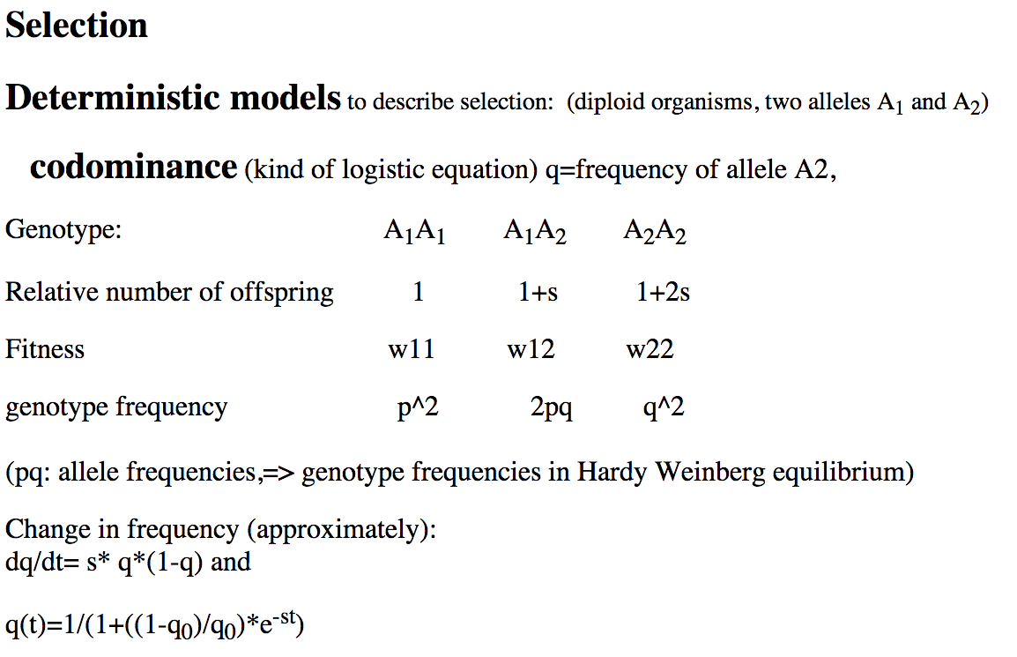
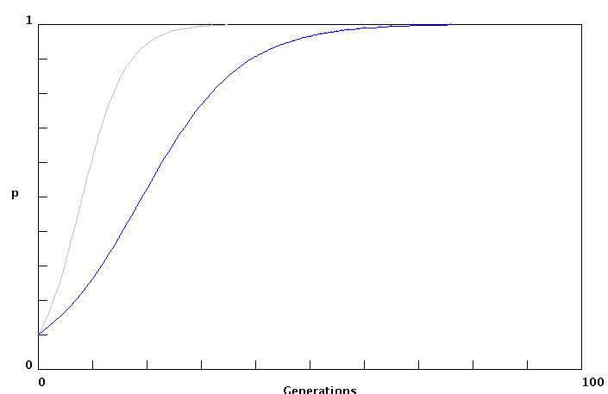
s=.2
s=.1

Slide 2
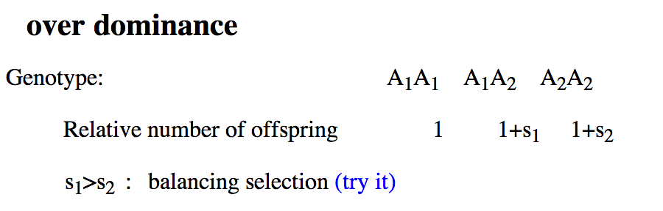
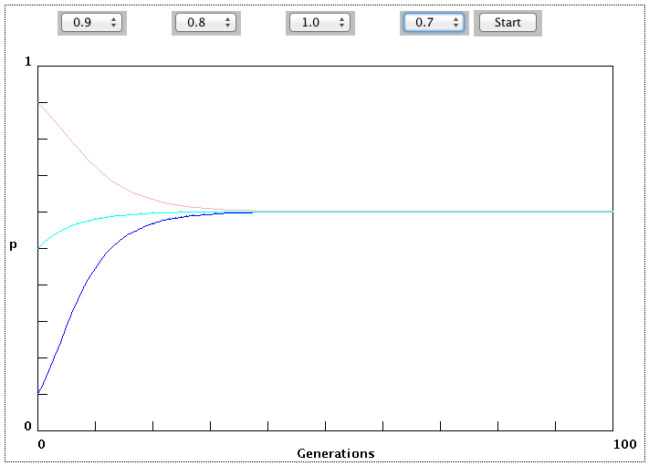

Slide 3
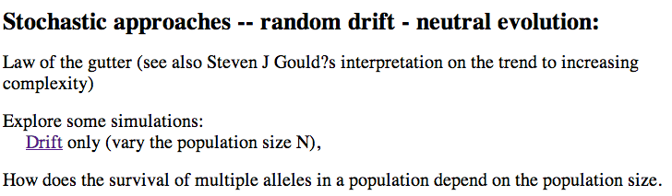
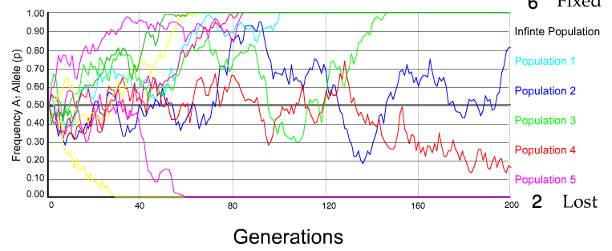
N=50 s=0
10 replicates

Slide 4
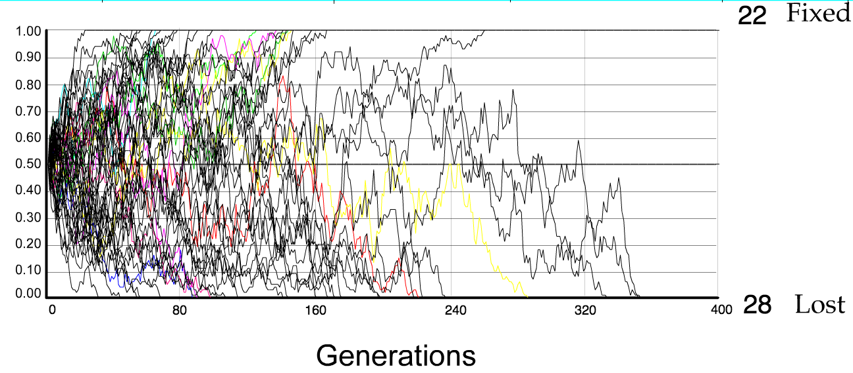
N=50 s=0
50 replicates

Slide 5
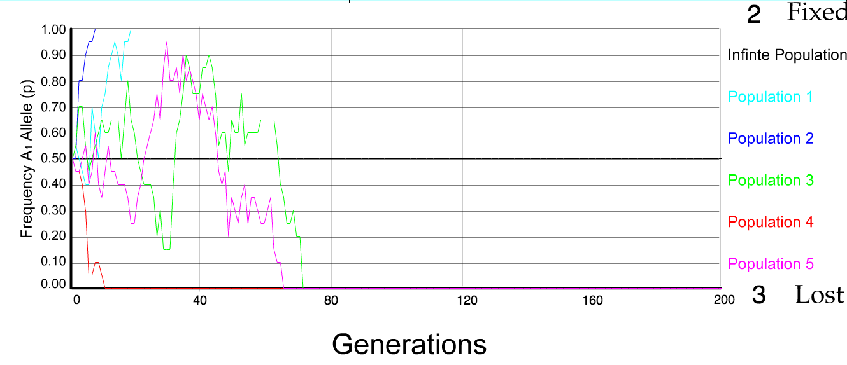
N=10 s=0
5 replicates

Slide 6
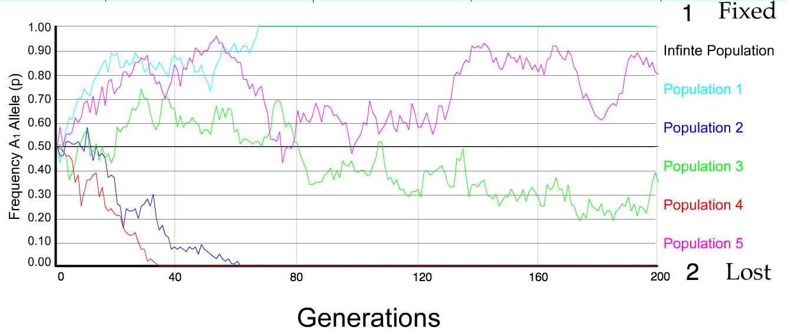
N=50 s=0
5 replicates

Slide 7
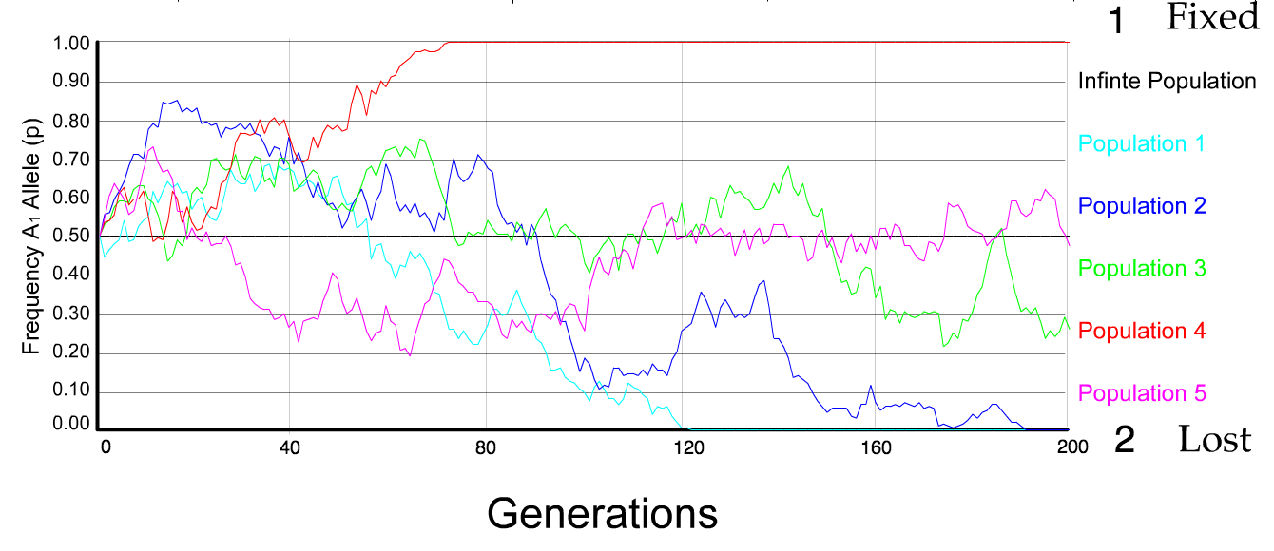
N=100 s=0
5 replicates

Slide 8
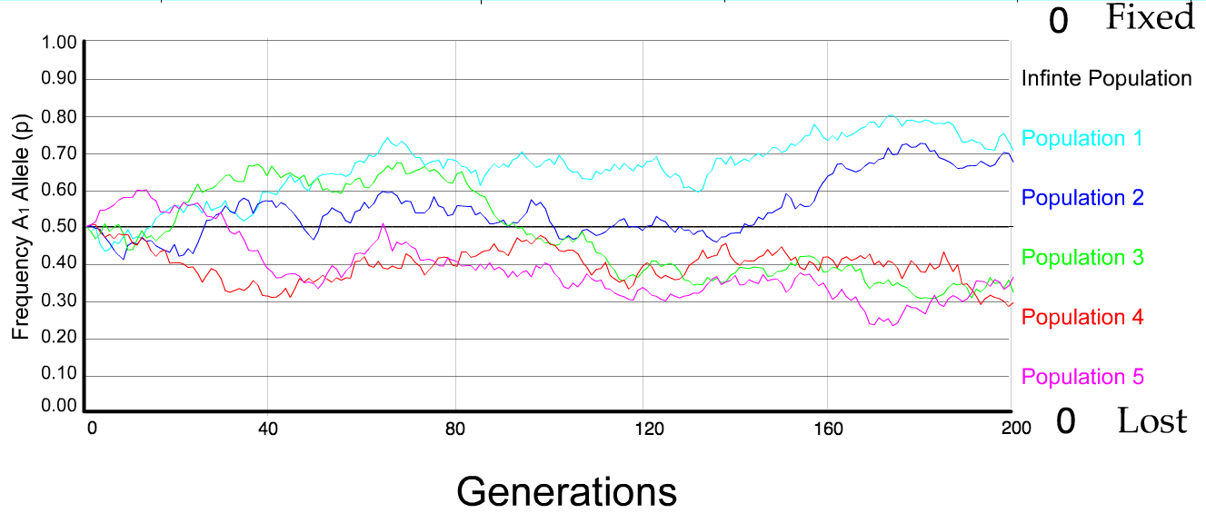
N=500 s=0
5 replicates

Slide 9
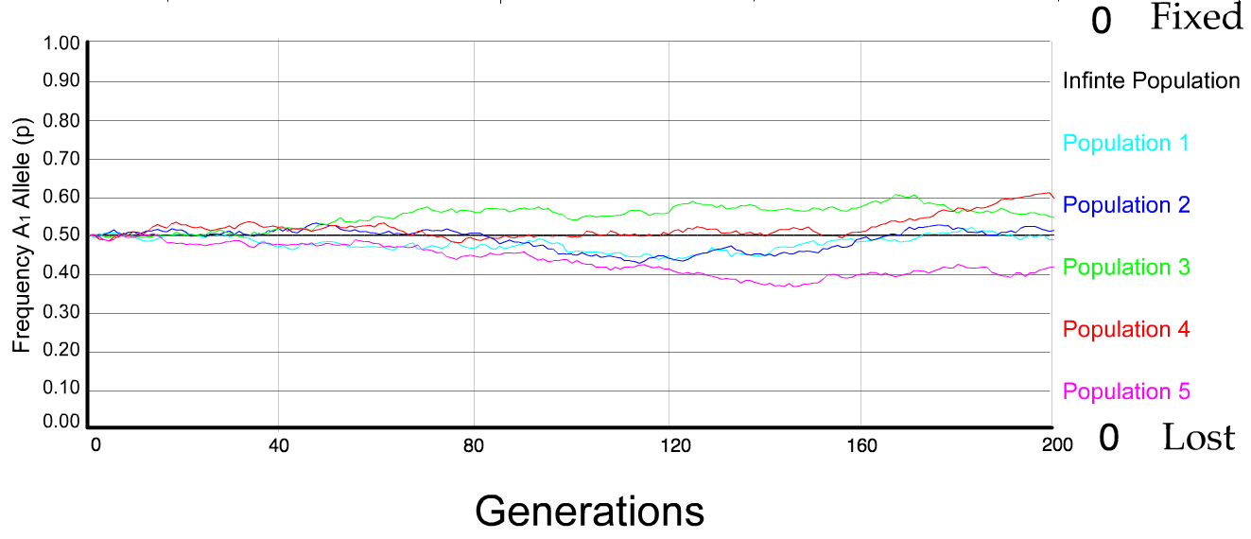
N=5000 s=0
5 replicates

Slide 10
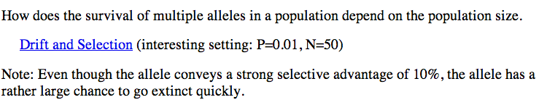
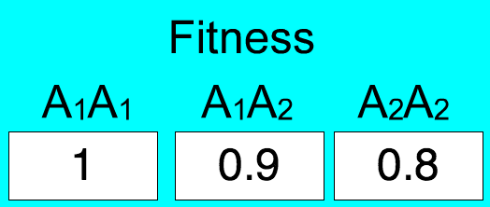
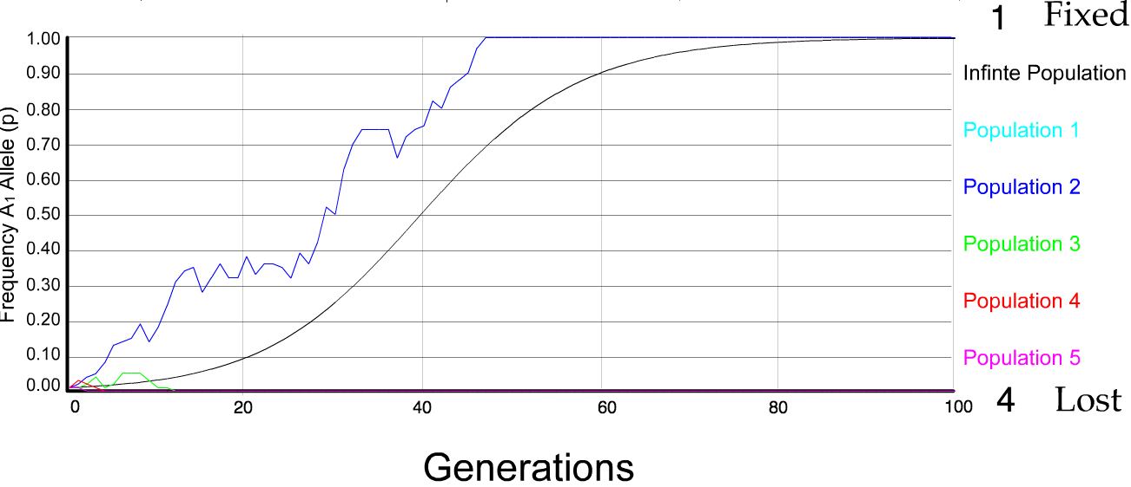
N=50 s=0.1
5 replicates

Slide 11
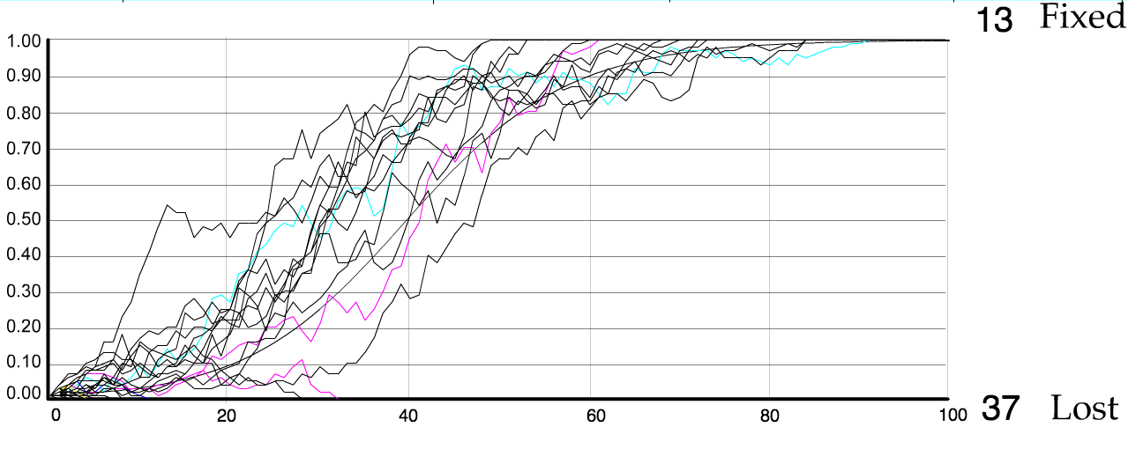
N=500 s=0.1
5 replicates

Slide 12
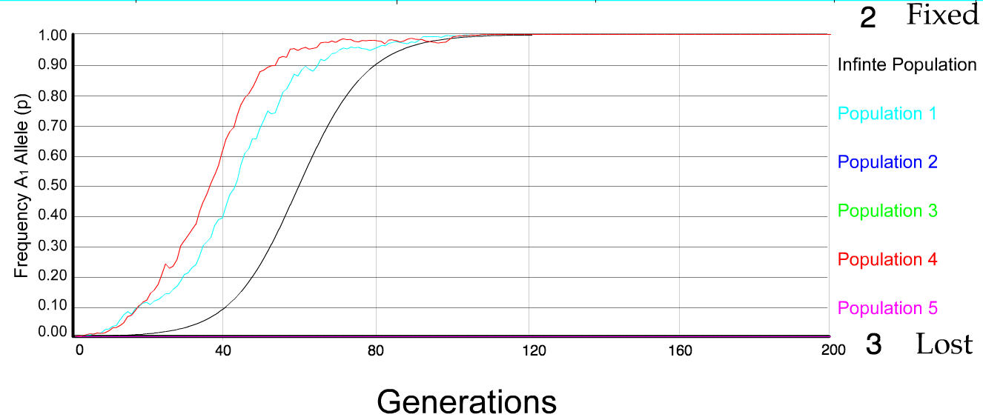
N=50 s=0.1
5 replicates

Slide 13
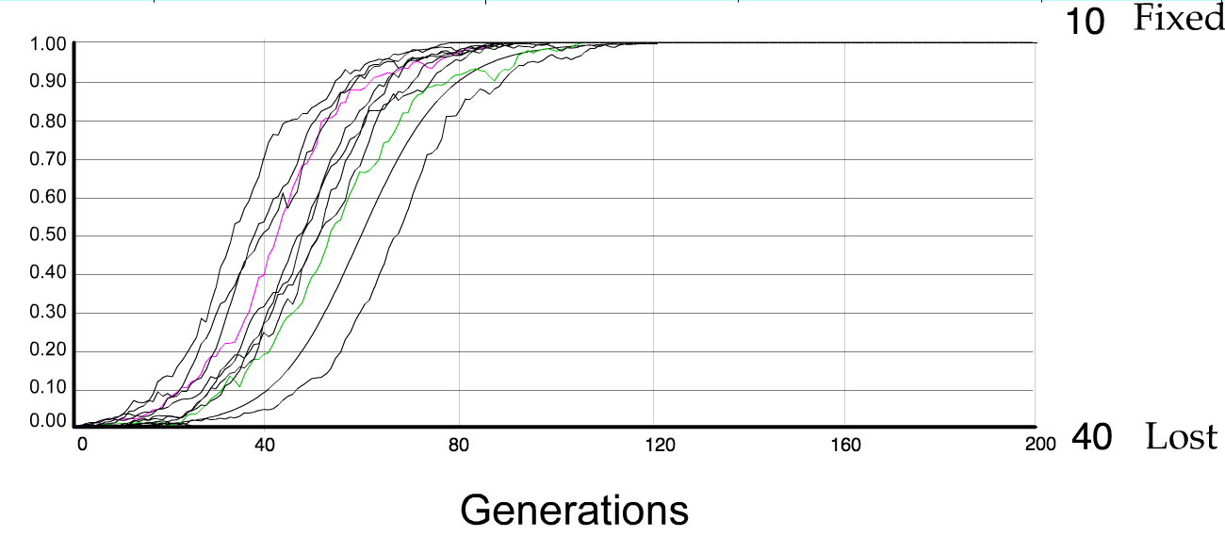
N=50 s=0.1
50 replicates

Slide 14
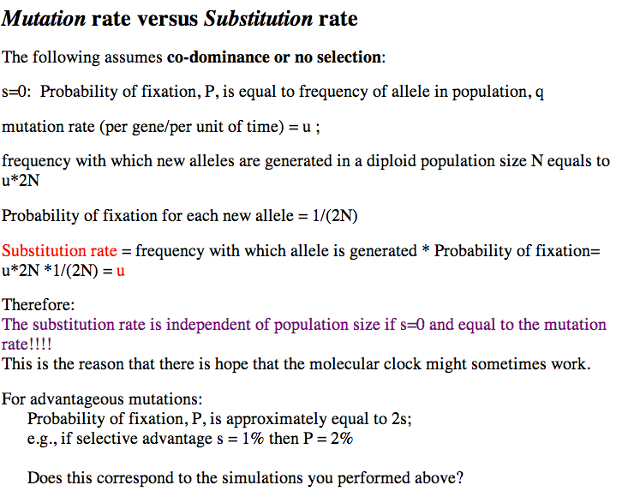

Slide 15
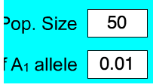
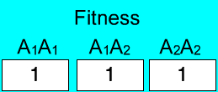

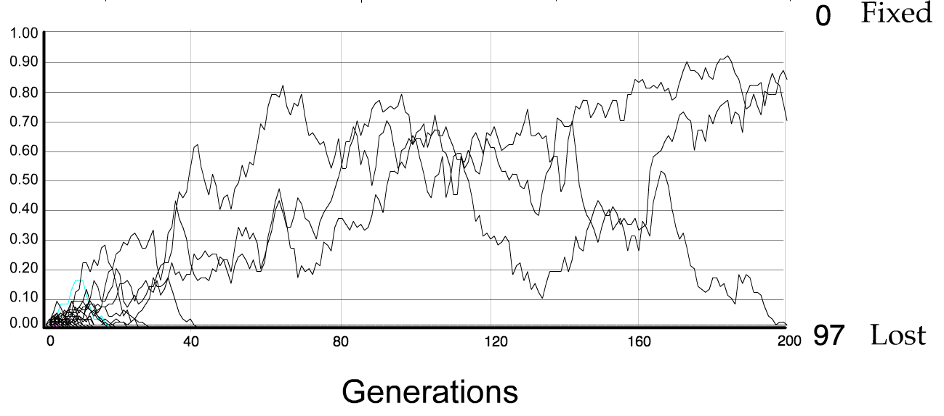
S=0: every allele has the same chance of being the lucky ancestor.

Slide 16
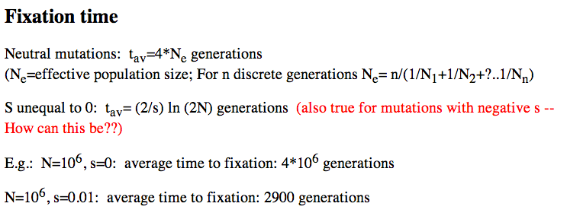

Slide 17
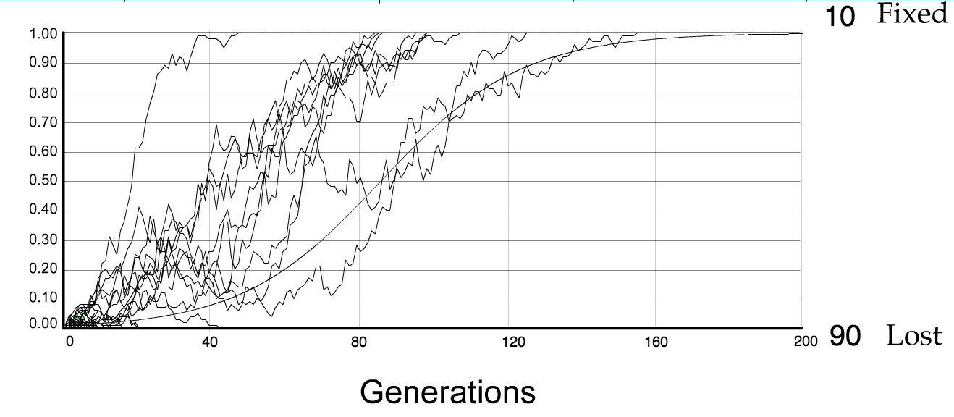
For advantageous mutations:
Probability of fixation, P, is approximately equal to 2s;
e.g., if selective advantage s = 5% then P = 10%
tav=2/s*log2N generations = 40*log100= 80

